Slide 1
Identify the most comment car model and predict used car price

Slide 2
Introduction
280 million vehicles in operation in the United
It is advantageous for a company or person who may want to buy or sell a used car to predict the price of the used car and explore the car dealerships within certain distance.

Slide 3
Data Description
Craigslist used car dataset (Published in Kaggle)
458213 records from Craigslist covers 51 states
26 attributes including build year, manufacturer, mode, condition, etc.
Remove missing observations with missing attributes
Remove observations built before 1930 and after 2020
Remove observations with price below 1000 or over 60000
Car dealers’ information from Forsquare API
The address of Texas Capitol was used as the searching location
Forsquare API returned 15 car dealers

Slide 4
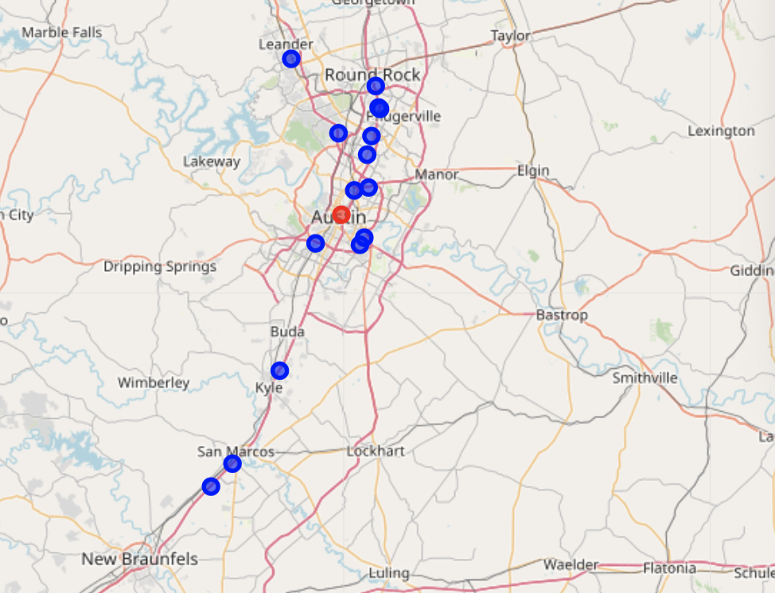
Used car dealers

Slide 5
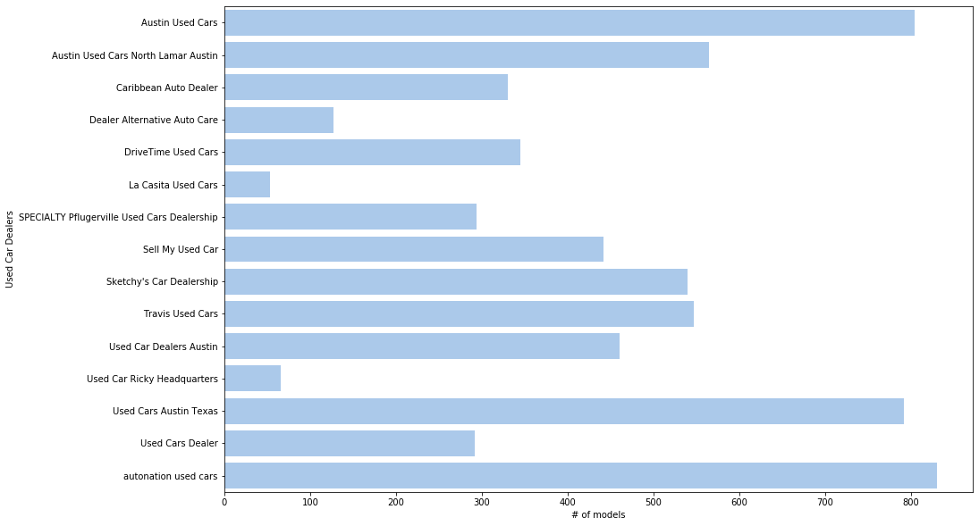
Identify the most comment car model
Craigslist used car data were merged into the dealer table based on given latitude and longitude information.
6487 vehicles find near the dealers and 445 unique models were linked to the dealers.

Slide 6
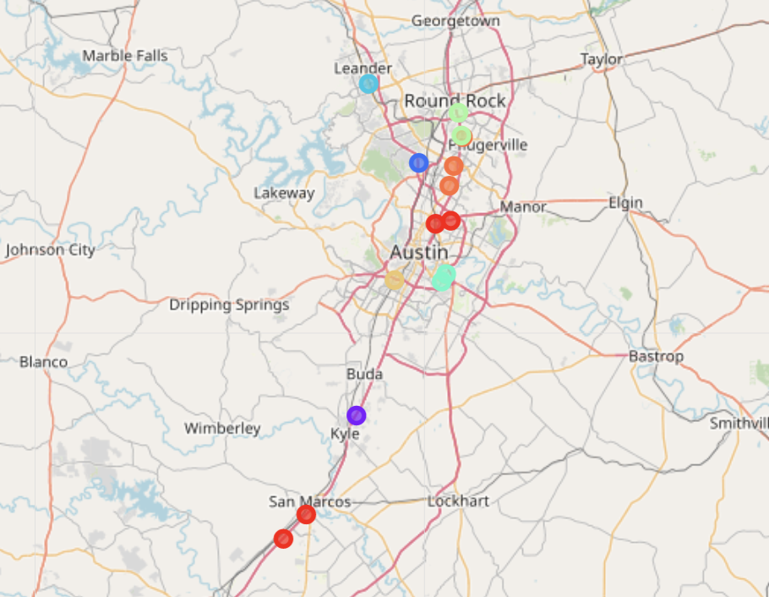
Identify the most comment car model

Slide 7
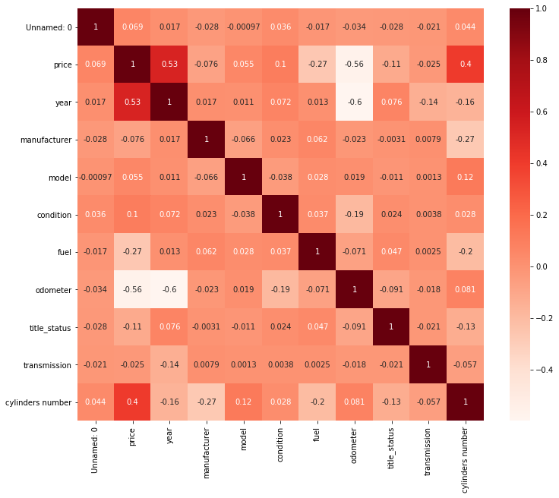
Predict used car price variable selection

Slide 8
Predict used car price variable selection
As shown in the correlation matrix, year, condition, cylinders, fuel, odometer and title_status have relatively high positive and negative relationship with price.
The correlation between odometer and year is -0.60
20% of the data as test set and trained the model with 80% of the data

Slide 9
Predict used car price Model Performance
Independent Variable | P-value
const | 0.00E+00
year | 0.00E+00
condition | 2.99E-11
cylinders | 0.00E+00
fuel | 3.33E-9
title_status | 2.02E-28
Mean Absolute Error | 5682.12
Mean Squared Error | 56566562.60
Root Mean Squared Error | 7521.07
R2 | 0.58

Slide 10
Predict used car price
Intercept | -2484668.99
year | 1236.82
condition | 535.03
cylinders number | 3163.44
fuel | -8209.31
title_status | -1254.56

Slide 11
Discussion & Conclusion
The most comment car model posted is CHEVROLET SILVERADO, and 60% of dealers’ most comment car model is truck.
The relatively lower gas price and large number of farm owners the reasons for this preference. The map below shows the location of each dealer with the most comment car model.
The factor that will increase the price including newer model, higher cylinder number, usage of diesel, clean title and good condition

